Slide 1
CSE 471 Project 3
James Dodge, Edward Maxwell, James Torres, Wyatt Roehler, Kiera Wheatley

Slide 2

Player
Player controls a ship
Ship can move left to right and fire rockets

Slide 3
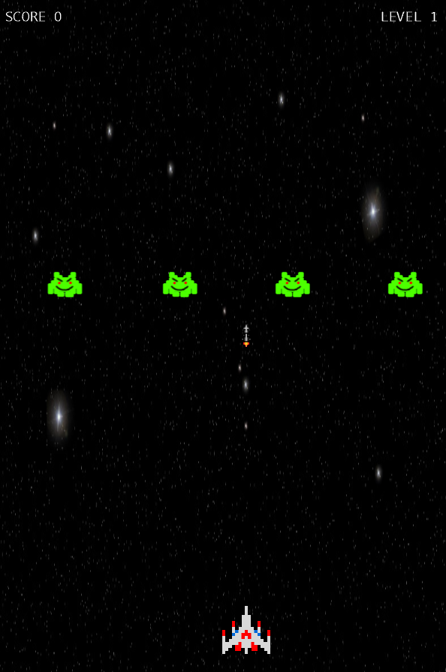
Controls
Left arrow key – Move left
Right arrow key – Move right
Space bar – Fire rocket

Slide 4




Levels
All enemies defeated → advance to next level
Enemies become faster
Enemy sprites change on certain levels

